Slide 1
NODE.JS
(The Backend Of MERN Stack)
Lecture 5

Slide 2
Today’s Agenda
Reading Files Using fs Module
Using readFileSync()
Handling Buffer
Using readFile()
Appending Data To A File

Slide 3
Reading file
The Node.js fs module provides two different functions for reading files:
readFileSync(filename,options)
readFile(filename, options, callback)
Both functions take a file name and options as arguments, open the file, read the content and returns it.

Slide 4
Difference ?
The key difference between them is that:
readFileSync() is synchronous.
readFile() is asynchronous.

Slide 5
Means ?
This means that readFile() will return immediately, before the file has been read and only its callback will be called when the read operation is completed.
While readFileSync() will block until the file has been read.

Slide 6
The fs.readFileSync() method
The fs.readFileSync() method is synchronous and is used to read data from a file.
It takes two arguments: the file path and the options indicating type of data and returns the file content
Syntax:
fs.readFileSync(file,options)

Slide 7
The fs.readFileSync() method
Syntax:
fs.readFileSync( file,options)
path: It is a String, Buffer or URL that denotes the path of the file or directory in which writing is to be done. If the file is not present an error will be thrown and if it is present it gets opened for reading
options: an object or a string to represent the encoding format of the file content to be read.
Return Value: Returns a buffer or a string

Slide 8
Exercise 8
WAS to open a file called message.txt in the text_files folder of your app .
Now read the contents of the file and display it in console.
Also handle errors which can occur during read operation

Slide 9
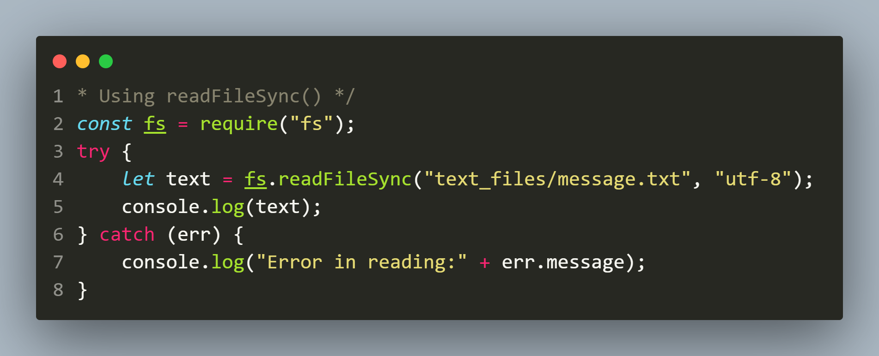
Solution

Slide 10
Why we used ‘utf-8’ ?
By default the readFileSync() method returns the file content as a Buffer object which is not human readable.
It is well suited for raw binary data.
However if we get a Buffer object we can still make it human readable by calling its toString() method

Slide 11
Exercise 9
Rewrite the previous code to read the file data as buffer object

Slide 12
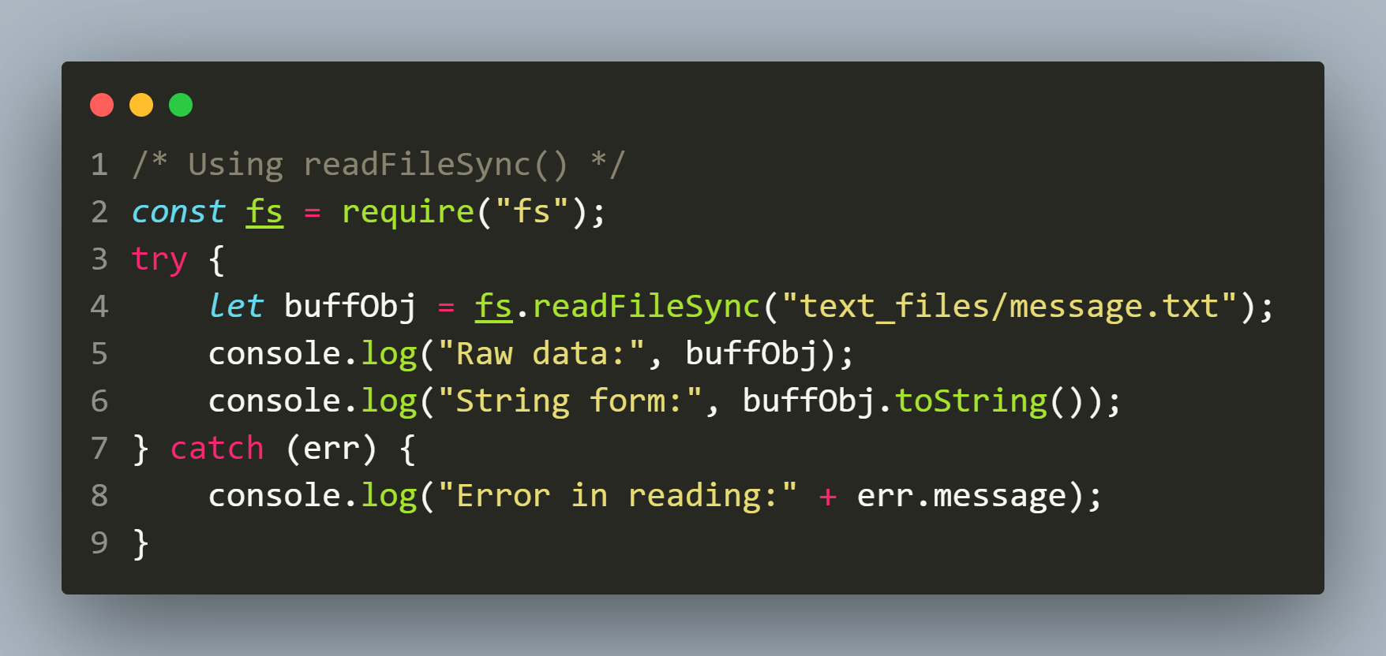
Previous code using buffer

Slide 13
The fs.readFile() method
The fs.readFile() method is asynchronous and is used to read data from a file.
It takes three arguments: the file path, the options indicating the encoding and a callback function that is called when the reading is complete.
Syntax:
fs.readFile(file,options,callback)

Slide 14
The fs.readFile() method
Syntax:
fs.readFile(file,encoding,callback)
path: It is a String, Buffer or URL that denotes the path of the file or directory in which writing is to be done. If the file is not present an error will be thrown and if it is present it gets opened for reading
options: an object or a string to represent the encoding format of the file content to be read.
callback: It is a function that would be called when the method has finished its execution. It takes two parameters:
err: If any error occurred.
data: Contents of the file.

Slide 15
Exercise 10
WAS to open a file called message.txt in the text_files folder of your app .
Now read the contents of the file and display it in console.
If the file is not present then display the message File not found and for any other error handle it by displaying actual error message

Slide 16
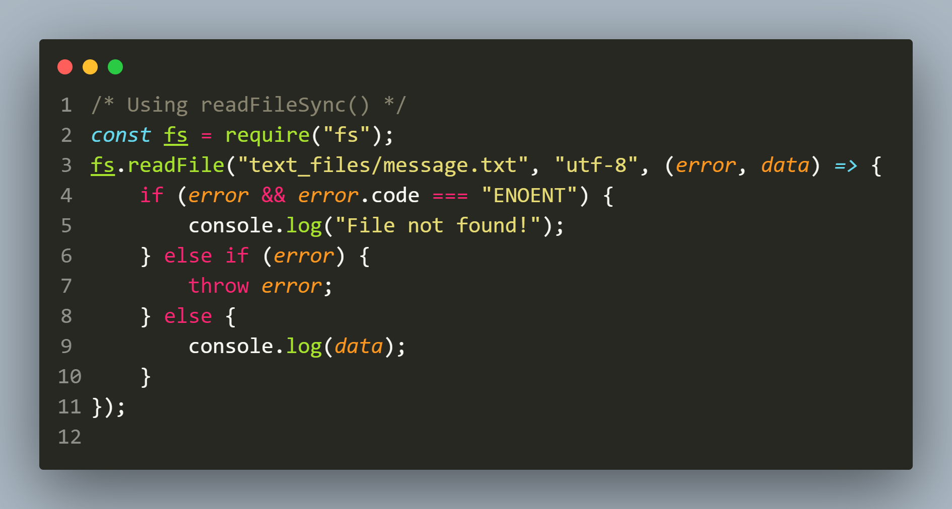
Solution

Slide 17
appending to a file
In addition to writing data to files, we may also need to append data to existing files without overwriting their contents.
The Node.js fs module provides two methods for appending data to files:
appendFileSync(file,data,options)
appendFile(filename, data,options,callback)
Both functions take a file path , data and options as arguments, create the file if it is not present and append the data to that file.

Slide 18
The fs.appendFileSync() method
The fs.appendFileSync() method is synchronous and is used to append data to a file.
It takes three arguments: the file path ,the data to write and an optional argument called options and returns nothing i.e undefined.
Syntax:
fs.appendSync(file,data,options)

Slide 19
The fs.appendFileSync() method
Syntax:
fs.appendFileSync(file,data,options)
path: It is a String, Buffer or URL that denotes the path of the file or directory in which writing is to be done. If the file is not present it gets created and if it is present it gets appended
data: It is a String, Buffer or Object that needs to be written into the file.
options: It is an string or object that can be used to specify optional parameters that will affect the output. It contains encoding, mode and flag values

Slide 20
Exercise 11
WAS to create/open a file called message.txt in the text_files folder of your app .
Now write the message Hello from Node.js in the file and at the end also write the current date and time in the file in locale specific format.

Slide 21
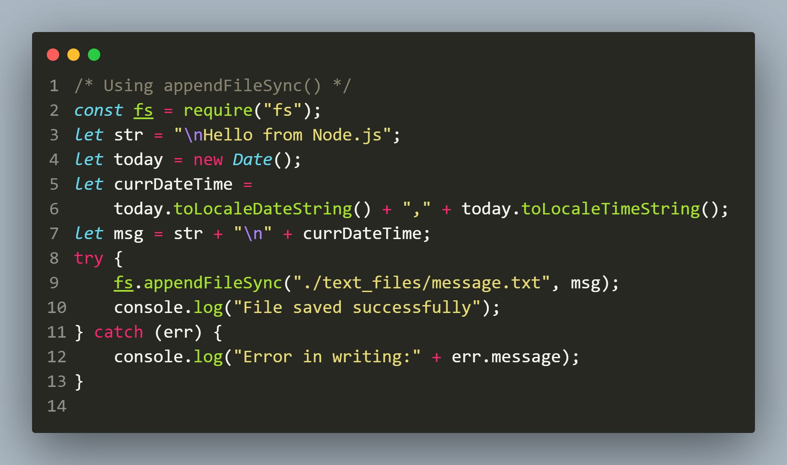
Solution

Slide 22
The fs.appendFile() method
The fs.appendFile() method is asynchronous and is used to append data to a file.
It takes four arguments: the file path, the data to write, an optional argument called options and a callback function that is called when the write is complete.
Like appendFileSync() this method also does not return any value
Syntax:
fs.writeFile(file,data,options,callback)

Slide 23
The fs.appendFile() method
Syntax:
fs.appendFile(file,data,options,callback)
path: It is a String, Buffer or URL that denotes the path of the file or directory in which writing is to be done. If the file is not present it gets created and if it is present it gets overwritten
data: It is a String, Buffer or Object that needs to be written into the file
options: It is an string or object that can be used to specify optional parameters that will affect the output. It contains encoding, mode and flag values
callback: It is a function that would be called when the method has finished its execution. It accepts a single argument representing error

Slide 24
Exercise 12
Rewrite the previous code using fs.appendFile() method

Slide 25
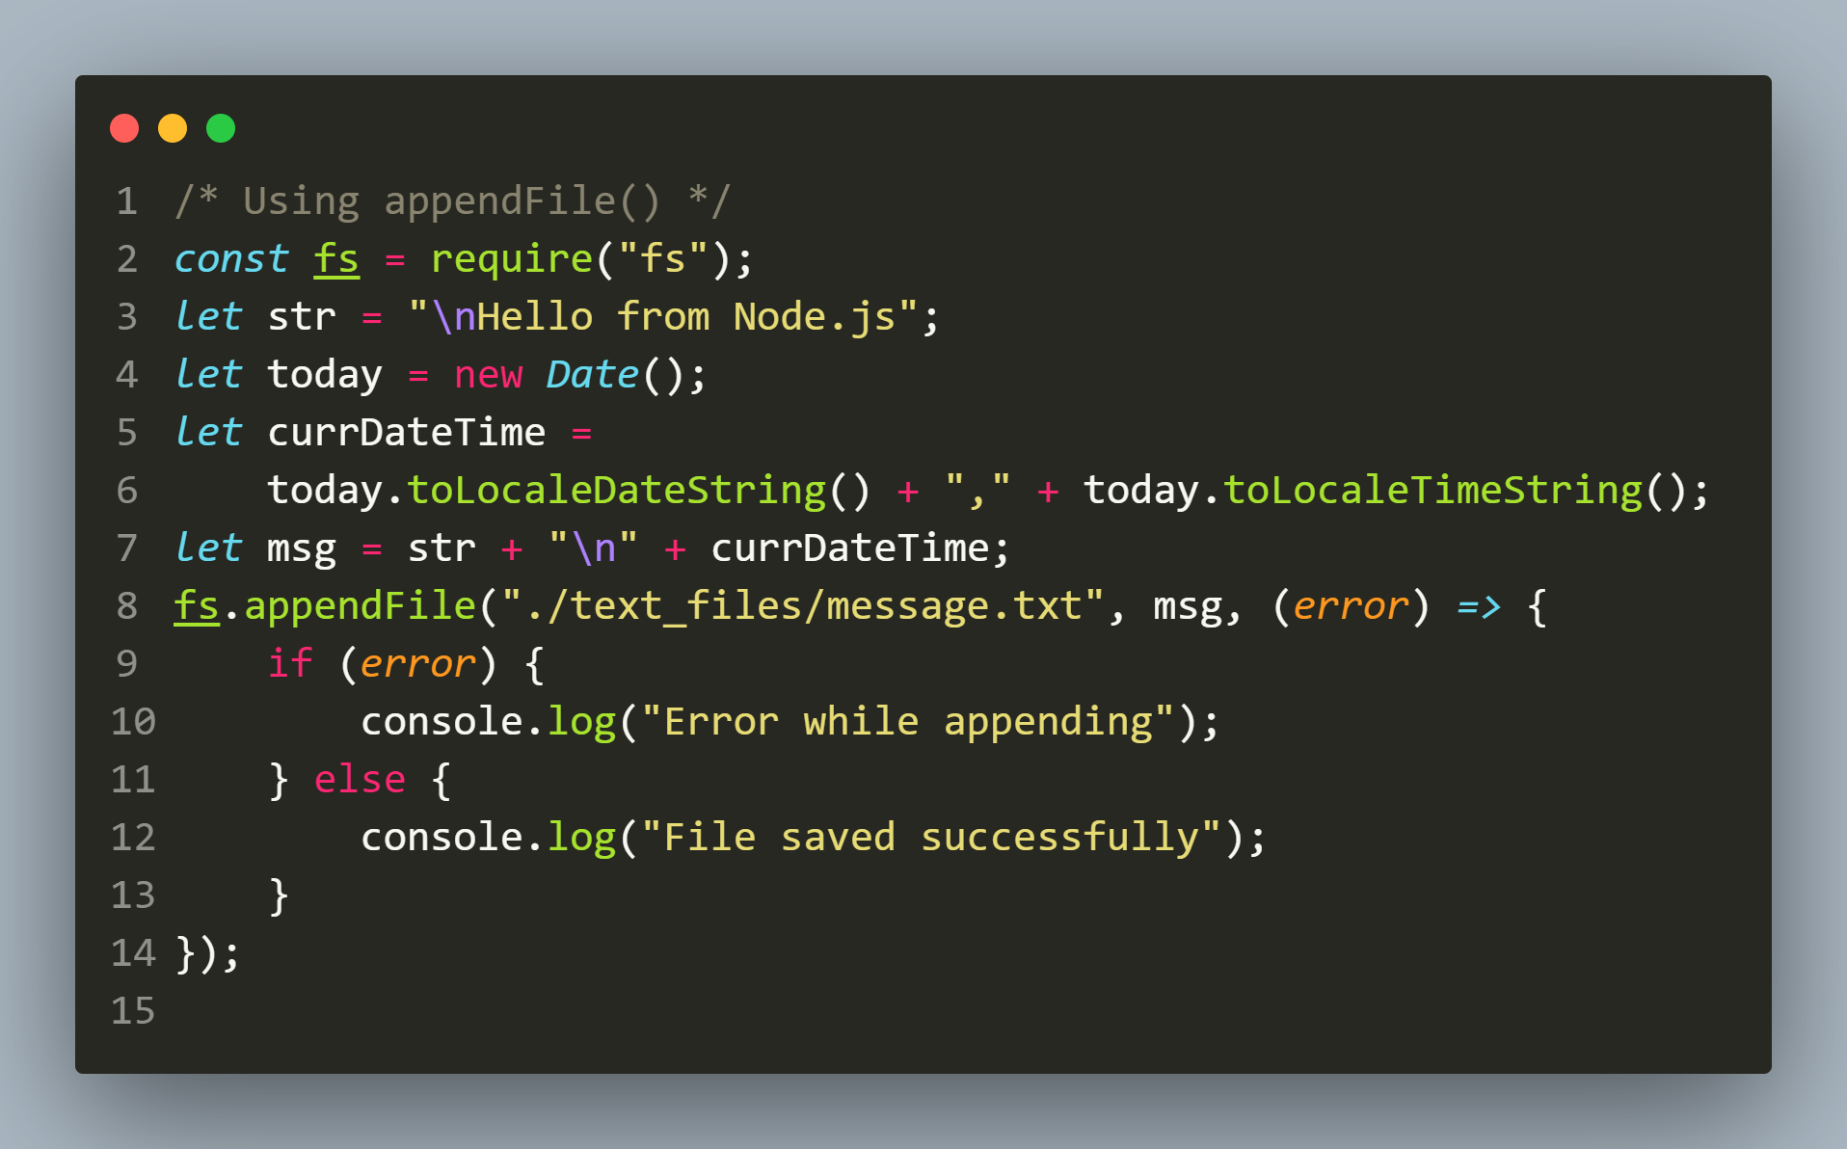
Solution

